Slide 1
Europanævnet
Hvad vil borgerne med Europas fremtid?

Slide 2
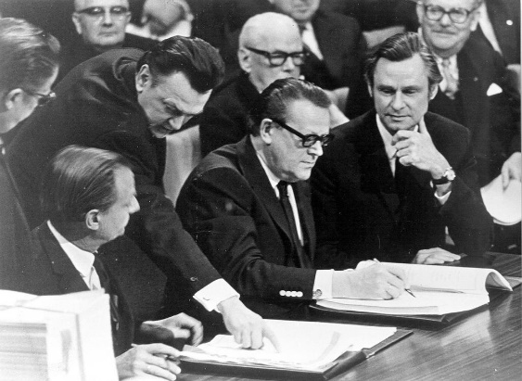

Slide 3
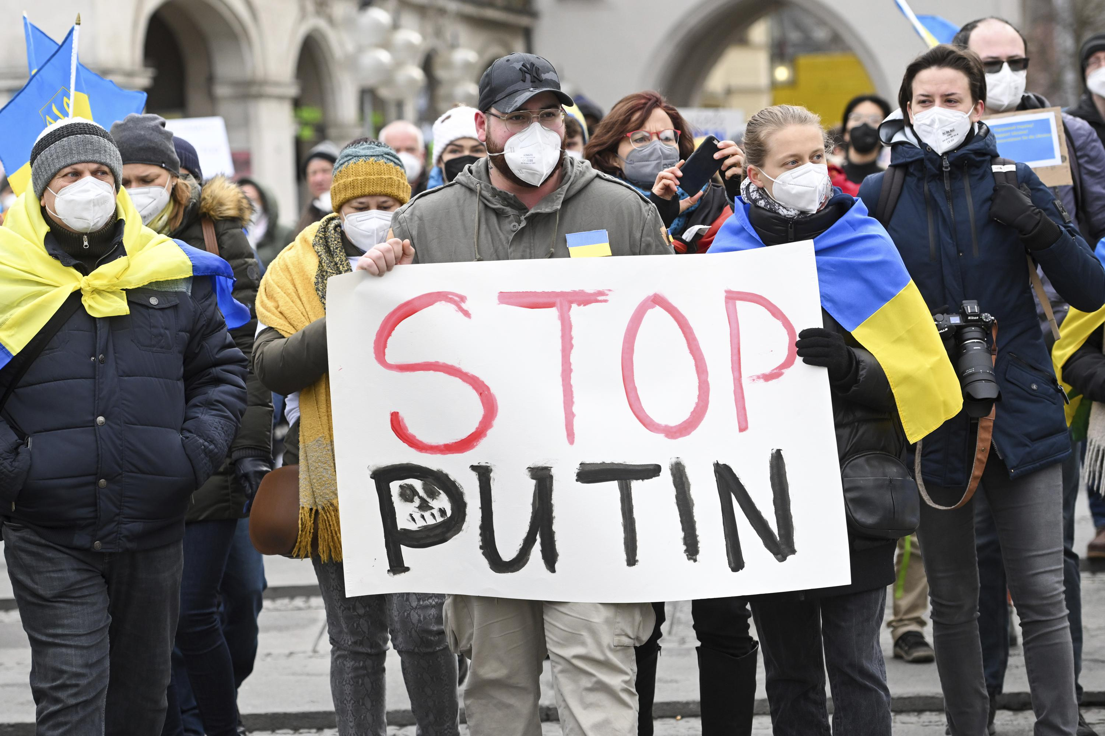

Slide 4
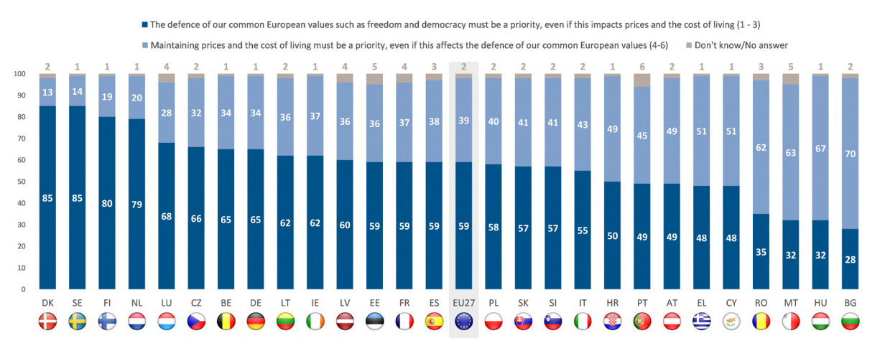

Slide 7
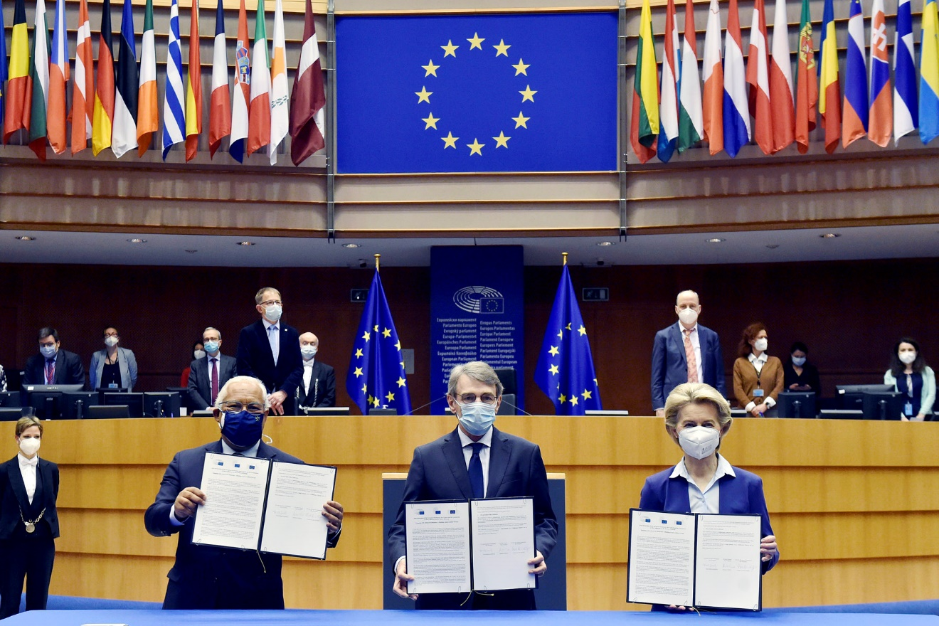

Slide 8
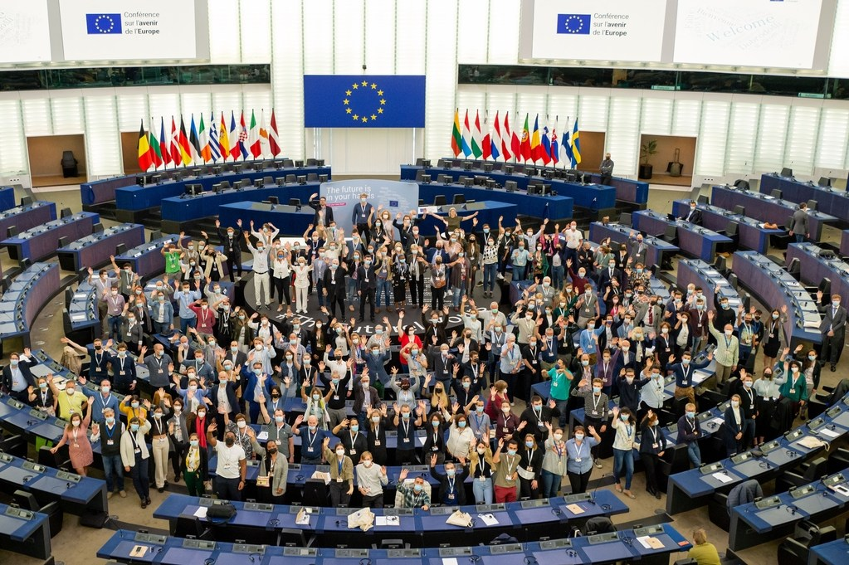

Slide 9
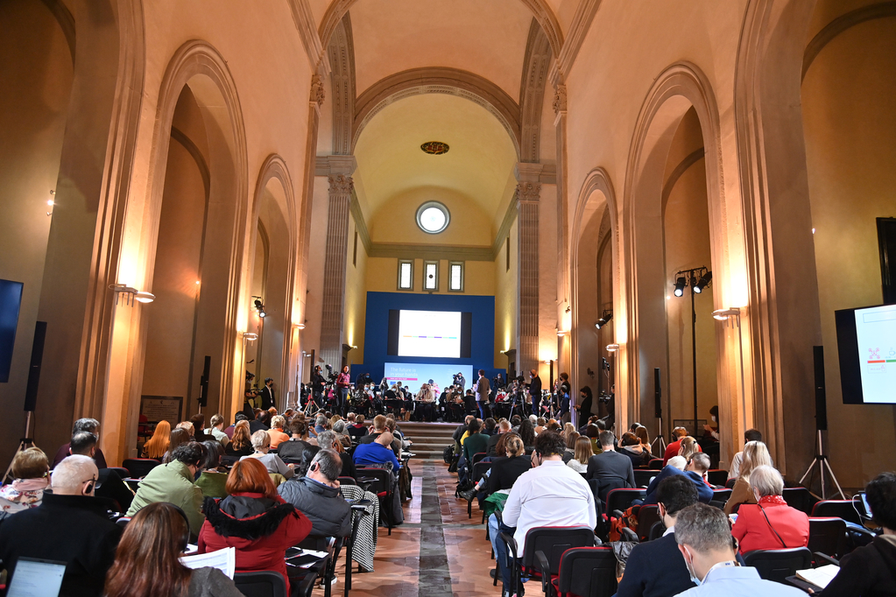

Slide 10
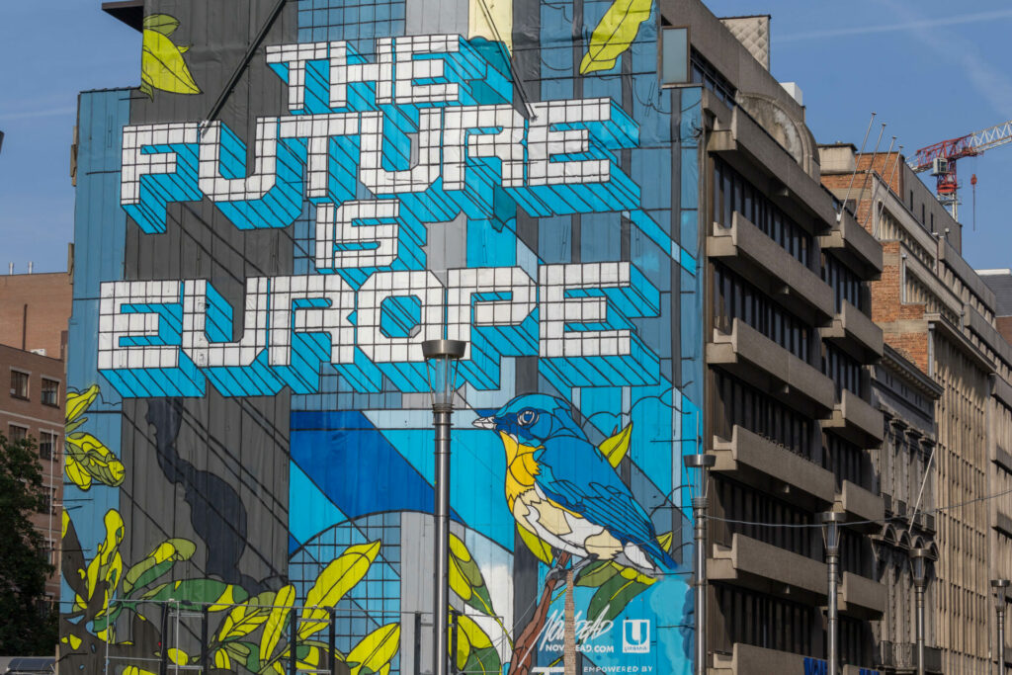
Notes:
Photo by Etienne Girardet on Unsplash
Photo by Boudewijn Huysmans on Unsplash
Photo by Andy Holmes on Unsplash

Slide 11
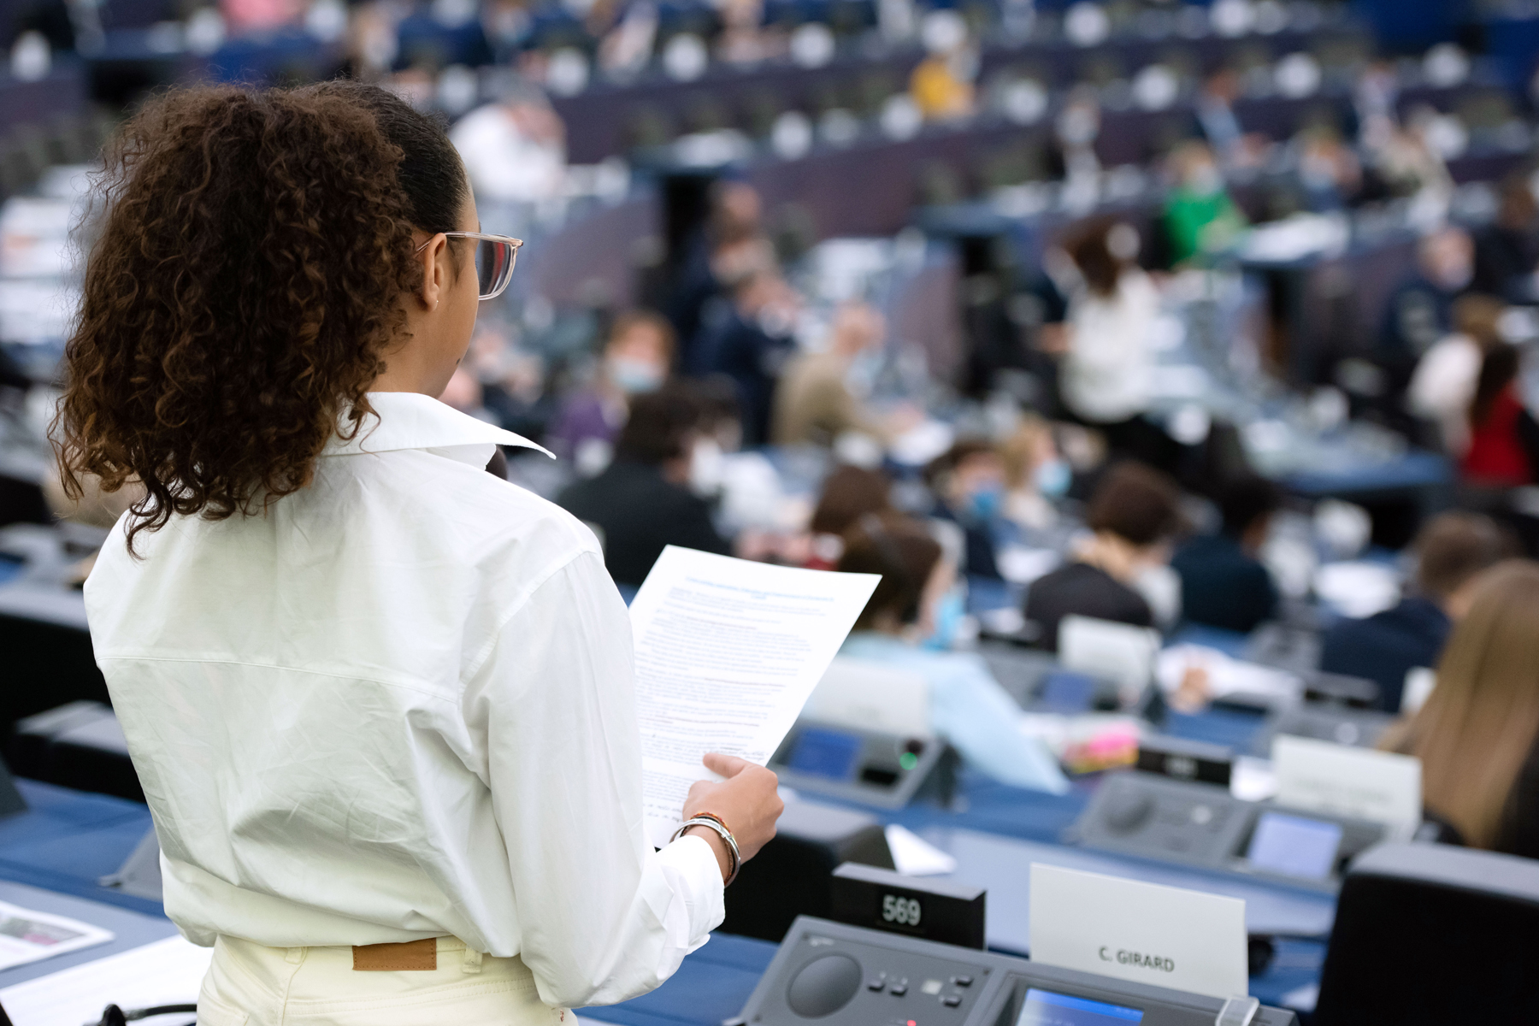
Notes:
Photo by Etienne Girardet on Unsplash
Photo by Boudewijn Huysmans on Unsplash
Photo by Andy Holmes on Unsplash

Slide 12
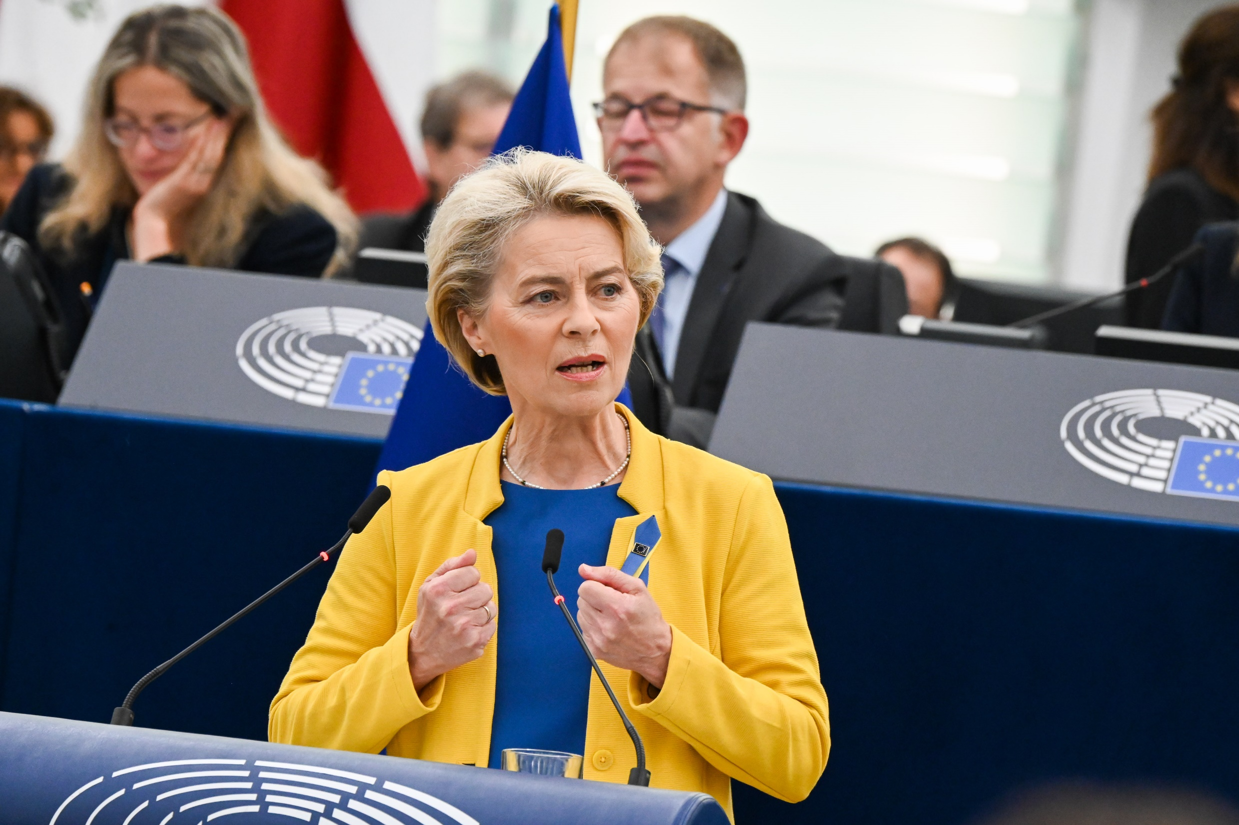
Notes:
Photo by Etienne Girardet on Unsplash
Photo by Boudewijn Huysmans on Unsplash
Photo by Andy Holmes on Unsplash

Slide 13
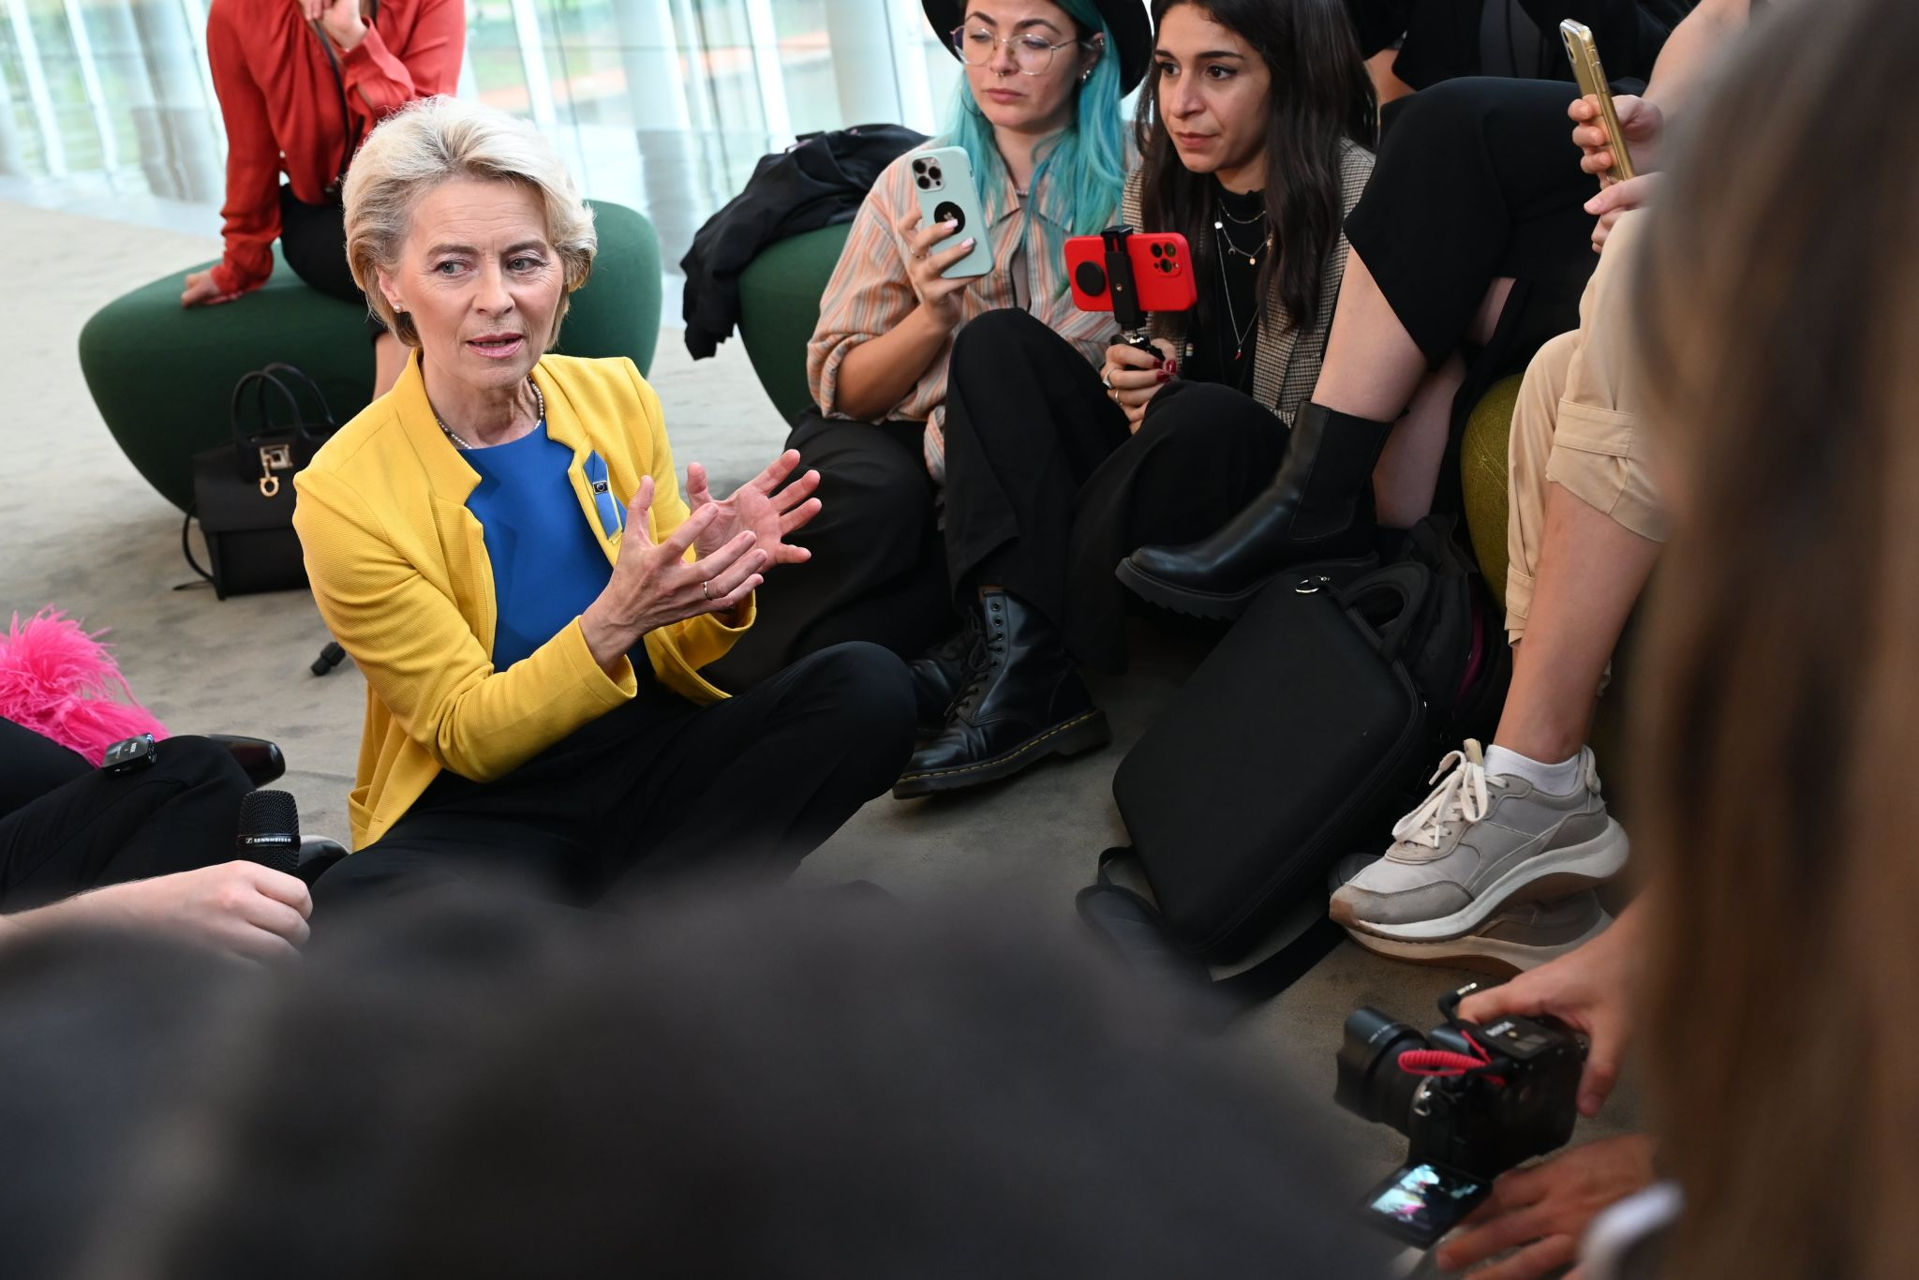
Notes:
Photo by Etienne Girardet on Unsplash
Photo by Boudewijn Huysmans on Unsplash
Photo by Andy Holmes on Unsplash

Slide 14
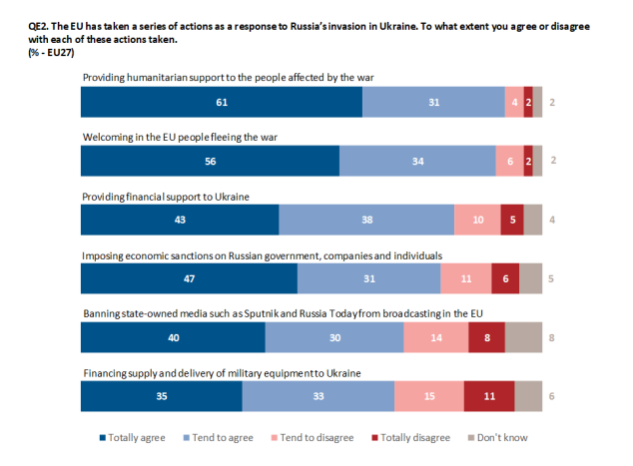
Notes:
Photo by Etienne Girardet on Unsplash
Photo by Boudewijn Huysmans on Unsplash
Photo by Andy Holmes on Unsplash

Slide 15
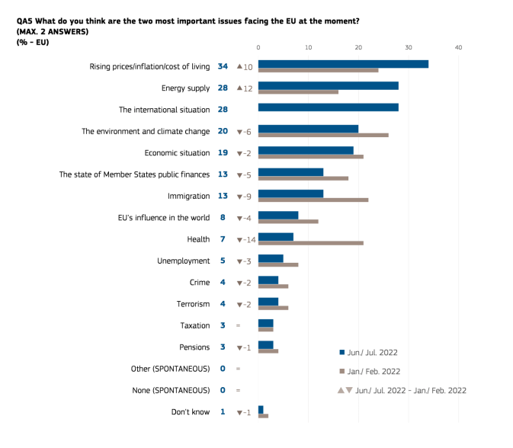
Notes:
Photo by Etienne Girardet on Unsplash
Photo by Boudewijn Huysmans on Unsplash
Photo by Andy Holmes on Unsplash

